Slide 1
4.6 Array as an Object
ITP3914 – Programming
Part 4 – Programming with Objects and Classes

Slide 2

Array as an object
An array is actually an object, thus it can have its own variable – length.
import java.util.*;
public class BasicArray {
public static void main(String [ ] args) {
Scanner keyboard = new Scanner(System.in);
int [ ] myArray = new int[5];
for (int i=0; i<myArray.length; i++) {
System.out.print("? ");
myArray[i] = keyboard.nextInt();
}
}
}
myArray
20b32c
int [ ]
length
5
20b32c

Slide 3

Passing arrays to methods
What actually being passed is the object reference, not the object itself.
Thus, array arr in the method refers to the same array myArray in main().
public class PassingArray {
}
public static void main(String [ ] args) {
int [ ] myArray = { 11, 22, 33, 44 };
System.out.println("Original Array:");
for (int i=0; i < myArray.length; i++)
System.out.println(myArray[i]);
modifyArray ( myArray ) ;
System.out.println("\nAfter calling modifyArray():");
for (int i=0; i < myArray.length; i++)
System.out.println(myArray[i]);
}
int [ ]
myArray
20b32c
length
4
11
22
33
44
20b32c
public static void modifyArray( int [ ] arr ) {
for (int j=0; j < arr.length; j++)
arr[j] *= 2;
}
arr
20b32c

Slide 4
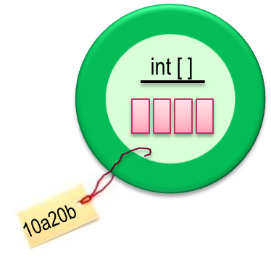


What actually is a 2D array?
public class WhatIs2D {
public static void main(String [ ] args) {
int [ ][ ] arr = new int[3][4];
for (int i=0; i < arr.length; i++)
for (int j=0; j < arr[i].length; j++)
arr[i][j] = i + j;
}
}
int [ ][ ]
arr
20b32c
10a20b
22b34d
33c42a
A 2D array is actually an 1D array of references to other 1D array objects.
20b32c

Slide 5
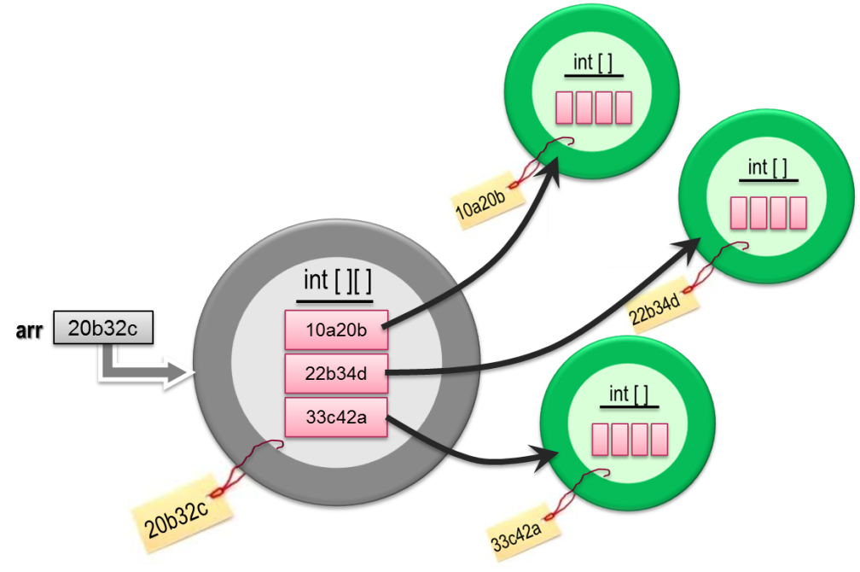
Lengths of 2D arrays
arr.length is the number of elements inside the array object referenced by arr.
public class WhatIs2D {
public static void main(String [ ] args) {
int [ ][ ] arr = new int[3][4];
for (int i=0; i < arr.length; if++)
for (int j=0; j < arr[i].length; j++)
arr[i][j] = i + j;
}
}
arr[i] is an element in the array object referenced by arr.
arr[i] is a reference referring to another 1D array object.
arr[i].length is thus the length of the array object referenced by arr[i].

Slide 6
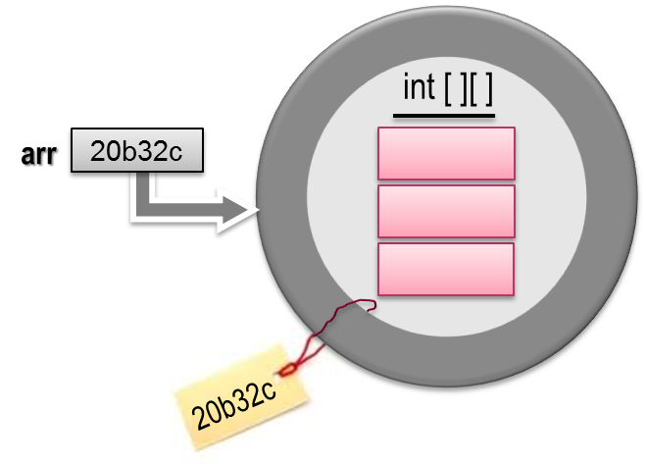
Irregular arrays
int [ ]
int [ ]
10a20b
public class Irregular {
public static void main(String [ ] args) {
int [ ][ ] arr;
arr = new int[3][ ];
arr[0] = new int[5];
arr[1] = new int[3];
arr[2] = new int[4];
for (int i=0; i < arr.length; i++)
for (int j=0; j < arr[i].length; j++)
arr[i][j] = i+j;
}
}
22b34d
10a20b
22b34d
33c42a

Slide 7
Irregular arrays
We first create an 1D array for referencing other rows.
int [ ] [ ] arr = new int[3][ ];
We then create the other 1D arrays one by one. Each new 1D array then becomes a row.
arr[0] = new int [5];
arr[1] = new int [3];
arr[2] = new int [4];
Since each row is being created independently, the rows can have different length. Thus, Java allows a 2D array with “irregular shape”.
Accessing an irregular array is no different from accessing a 2D array created statically.
However, with irregular array, we must use arr[i].length to determine the number of elements in each row.

Slide 8
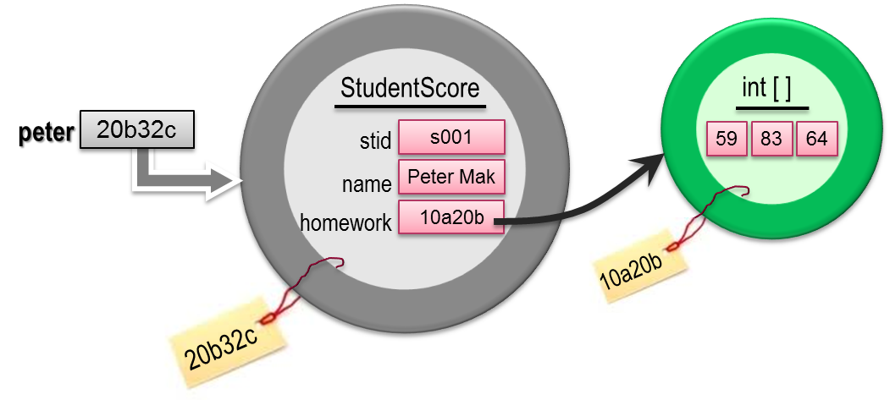
Objects with array variables
public class StudentScore {
private String stid;
private String name;
private int [ ] homework;
public StudentScore(String stid, String name) {
this.stid = stid;
this.name = name;
homework = new int[3];
}
public void setHomework(int index, int score) {
if (index >= 0 && index < homework.length) {
if (score>=0 && score<=100)
homework[index]=score;
}
}
public double homeworkAvg() {
int sum = 0;
for (int i=0; i<homework.length; i++)
sum += homework[i];
return (double) sum / homework.length;
}
}
public class StudentScoreUser {
public static void main(String [ ] args) {
StudentScore peter = new StudentScore("s001", "Peter Mak");
peter.setHomework(0, 59);
peter.setHomework(1, 83);
peter.setHomework(2, 64);
System.out.println("Average = " + peter.homeworkAvg());
}
}

Slide 9
Array of Objects
public class HdSe {
public static void main(String [ ] args) {
Student [ ] hdse = new Student[4];
hdse[0] = new Student("Andy", 40);
hdse[1] = new Student("Brian", 60);
hdse[2] = new Student("Candy", 75);
hdse[3] = new Student("David", 82);
int sum=0;
for (int i=0; i<hdse.length; i++) {
System.out.println(hdse[i]);
sum += hdse[i].getScore();
}
System.out.println("Average = " +
(double) sum / hdse.length);
}
}
public class Student {
private String name;
private int score;
public Student(String name, int score) {
this.name = name;
this.score = score;
}
public int getScore() {
return score;
}
public String toString() {
return name + ": " + score;
}
}
(C) VTC, Prepared by sm-lau@vtc.edu.hk

Slide 10
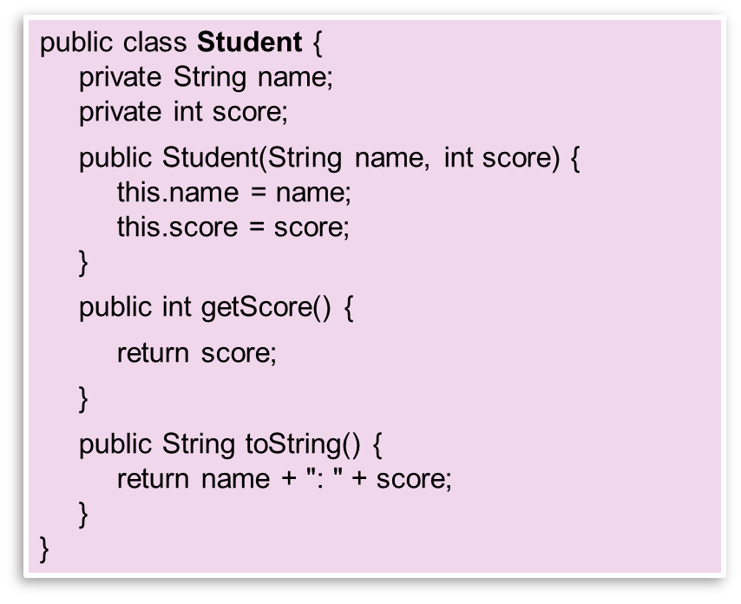
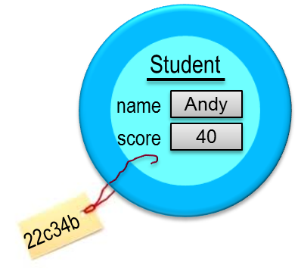
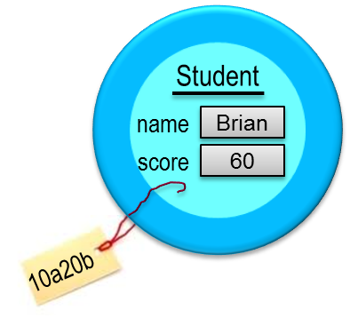
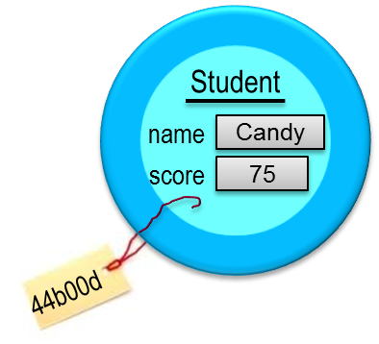
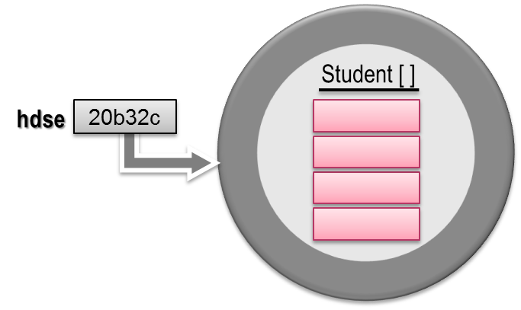





This creates an array of Student references.
That is, each array element is capable of storing a reference to a Student object instance.
However, the Student object instances HAVE NOT BEEN CREATED yet.
public class HdSe {
public static void main(String [ ] args) {
Student [ ] hdse = new Student[4];
hdse[0] = new Student("Andy", 40);
hdse[1] = new Student("Brian", 60);
hdse[2] = new Student("Candy", 75);
hdse[3] = new Student("David", 82);
int sum=0;
for (int i=0; i<hdse.length; i++) {
System.out.println(hdse[i]);
sum += hdse[i].getScore();
}
System.out.println("Average = " +
(double) sum / hdse.length);
}
}
sum += hdse[i].getScore();

Slide 11
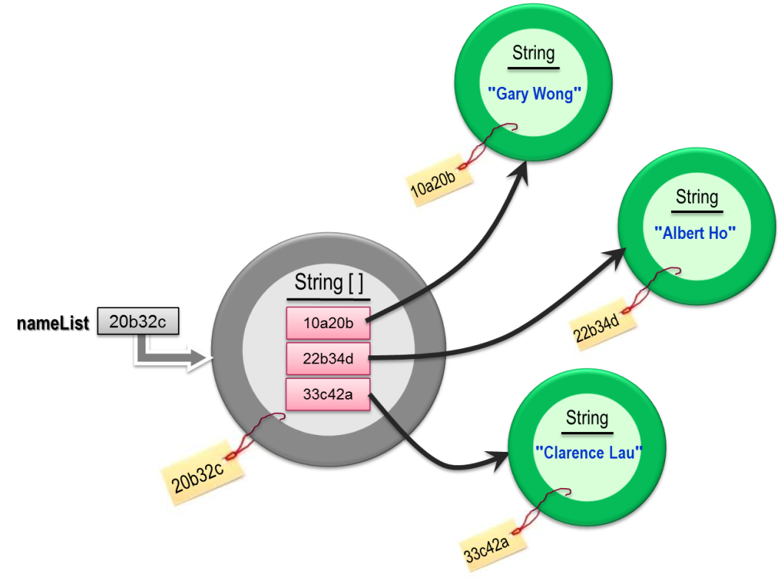
Array of Strings
C:\> java ArrString
? Gary Wong
? Albert Ho
? Clarence Lau
==========
Gary Wong:9
Albert Ho:9
Clarence Lau:12
A String is actually an object in Java.
Thus, working with an array of String is actually no difference from working with an array of objects.
import java.util.*;
public class ArrString {
public static void main(String [ ] args) {
Scanner keyboard =
new Scanner(System.in);
String [ ] nameList = new String[5];
for (int i=0; i<nameList.length; i++) {
System.out.print("? ");
nameList[i] = keyboard.nextLine();
}
System.out.println(“==========“ );
for (int i=0; i<nameList.length; i++)
System.out.println(nameList[i] + ":"
+ nameList[i].length() );
}
}

Slide 12

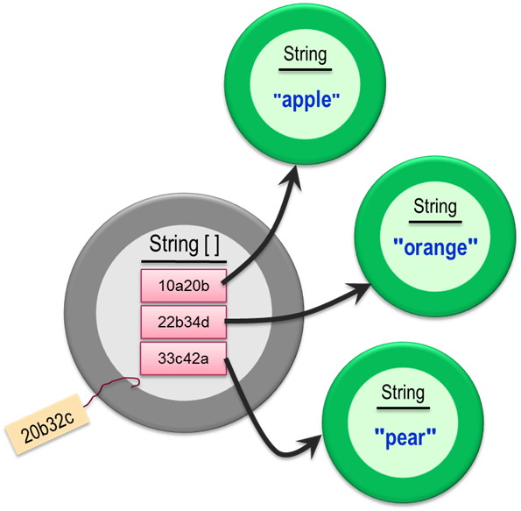
Command Line Arguments
C:\> java CmdLine apple orange pear
C:\> java CmdLine apple orange pear
# of arguments = 3
0: apple
1: orange
2: pear
20b32c
public class CmdLine {
public static void main( String [ ] args ) {
System.out.println("# of arguments = " + args.length );
for (int i=0; i < args.length; i++)
System.out.println(i + ": " + args[i] );
}
}
args
20b32c

Slide 13

END.

Slide 14
The slides from now on are the source for preparing the pictures.
DON’T show them to students.

Slide 15
numStudent
0
s1
19e15c
s2
20b34e
s3
22c19d
name
name
name
Peter
John
Mary
19e15c
20b34e
22c19d
15

Slide 16
2D array
int [ ][ ]
arr
20b32c
20b32c

Slide 17
Array of strings
String
"Gary Wong"
10a20b
String
"Albert Ho"
String [ ]
nameList
20b32c
10a20b
22b34d
22b34d
33c42a
String
"Clarence Lau"
20b32c
33c42a

Slide 18
Command line args
String
"apple"
args
20b32c
String
String [ ]
"orange"
10a20b
22b34d
33c42a
String
20b32c
"pear"

Slide 19
Objects with array variables
StudentScore
int [ ]
peter
20b32c
stid
s001
59
83
64
name
Peter Mak
homework
10a20b
10a20b
20b32c

